Slide 1
Text Data Mining

Slide 2
What is text data mining
Text data mining, also known as text mining or text analytics, is the process of extracting high-quality information from unstructured text data using computational techniques.
It involves discovering patterns, relationships, and new insights from text resources like documents, websites, and social media.
This process often utilizes natural language processing (NLP), machine learning, and data mining techniques to analyze text and reveal meaningful information.

Slide 3
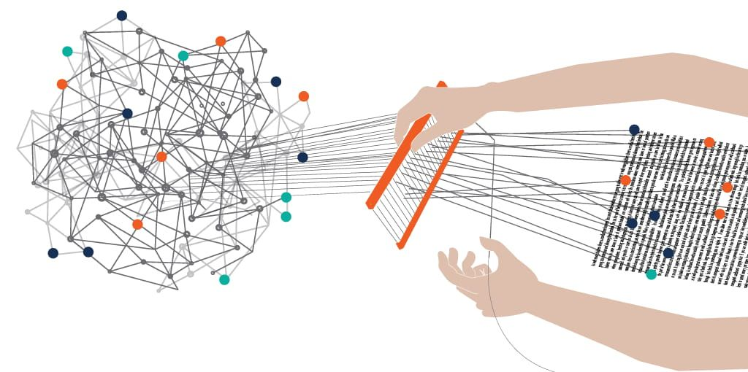

Slide 4
Key aspects of text data mining:
Unstructured data: Text mining deals with unstructured data, which is typically not organized in a predefined format.
Pattern discovery: It aims to identify patterns, trends, and relationships within the text data that might not be obvious through manual analysis.
Information extraction: Text mining extracts specific information, entities, and facts from the text, transforming it into a structured format.
Knowledge discovery: By analyzing text, text mining can lead to new knowledge, insights, and understanding of the subject matter.

Slide 5
Examples of text mining applications:
Sentiment analysis: Determining the sentiment (positive, negative, neutral) expressed in customer reviews or social media posts.
Topic modeling: Identifying the main topics discussed in a collection of documents.
Entity recognition: Extracting named entities like people, organizations, and locations from text.
Fraud detection: Identifying potential fraud by analyzing loan applications or insurance claims.
Trend analysis: Discovering emerging trends in social media conversations or news articles.
Research analysis: Helping researchers analyze large amounts of text data to answer specific research questions.

Slide 6
Differentiate between Classification and Clustering in Data Mining

Slide 7
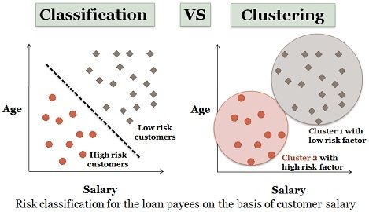

Slide 8
Parameter | CLASSIFICATION | CLUSTERING
Type | used for supervised learning | used for unsupervised learning
Basic | process of classifying the input instances based on their corresponding class labels | grouping the instances based on their similarity without the help of class labels
Need | it has labels so there is need of training and testing dataset for verifying the model created | there is no need of training and testing dataset
Complexity | more complex as compared to clustering | less complex as compared to classification
Example Algorithms | Logistic regression, Naive Bayes classifier, Support vector machines, etc. | k-means clustering algorithm, Fuzzy c-means clustering algorithm, Gaussian (EM) clustering algorithm, etc.

